Slide 1

Welcome to
The Yatoma Show!

Slide 2

Welcome to 1st Semester!
NOW FASTEN YOUR SEATBELTS!!!!

Slide 3

Ms. Y’s Classroom Rules:

Slide 4

1. Be on time!

Slide 5

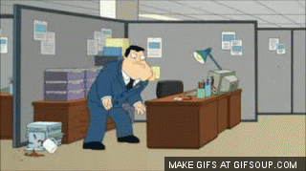
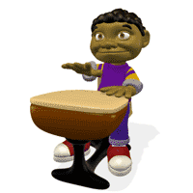
Be in your seat!

Slide 6

If you’re tardy, you will be marked tardy!
3 tardies is a detention.

Slide 7
Quick note:
You must “check in” at your center if you are more than 20 minutes late.

Slide 8

2. Be prepared!

Slide 9

Every day you need:
ID
“binder”
pen or pencil

Slide 10

3. Behave
all hour!

Slide 11

DO NOT:

Slide 12

1. DO NOT. . . talk when Ms. Yatoma is talking.

Slide 13

2. DO NOT . . . bully, make fun of, or laugh at anyone.

Slide 14

3. DO NOT . . . waste Ms. Yatoma’s markers and supplies!

Slide 15
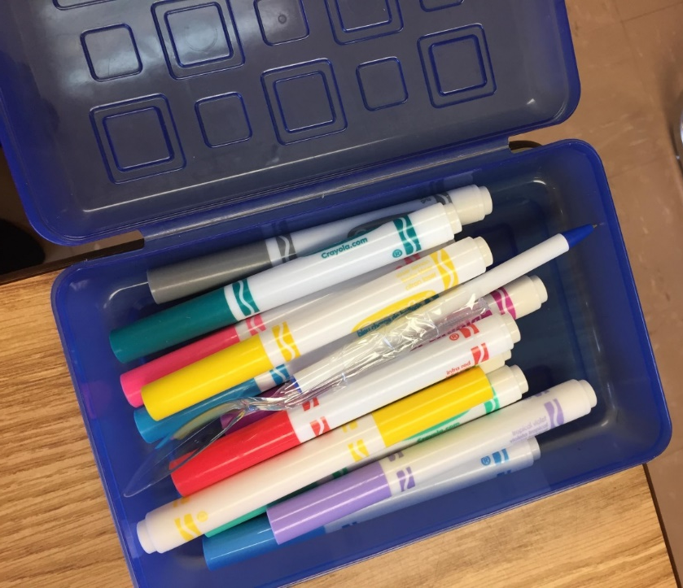
DO NOT . . .
put your markers
in a
different
box!

Slide 16

5. ALWAYS . . .
pay attention!

Slide 17


6. DO NOT . . . use your cellphone or headphones unless Ms. Yatoma says it’s okay!

Slide 18
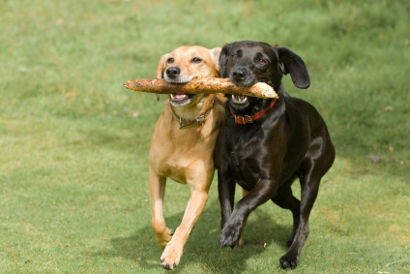
7. ALWAYS . . .
be respectful!

Slide 19
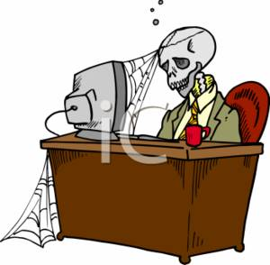
8. ALWAYS . . .
stay in
your seat
until the
bell rings!

Slide 20

4. Grading Rubric

Slide 21
25% Homework & Classwork
75% Quizzes, Tests, & Projects

Slide 22

5. Absent work

Slide 23
Check the purple bin for the day you were absent.
The bin is in the front of the classroom.
Look for the day you were absent!

Slide 24

6. Passes

Slide 25

To use the bathroom or to leave the classroom ...

Slide 26
... I need:
*My ID
*Complete the information on YELLOW Clipboard and Ms. Yatoma will sign it!

Slide 27

For other passes:
*Ms. Y. will sign your agenda.

Slide 28

7. Dress Code

Slide 29
I follow the WMHS Dress Code.
*SO DEAL WITH IT.

Slide 30
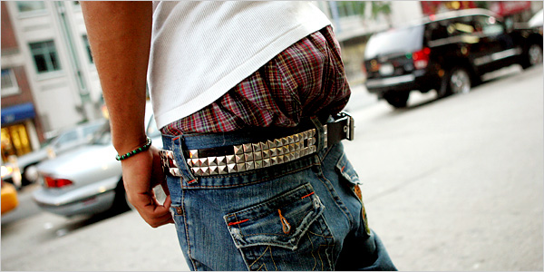

DO NOT:
1. Show your underwear!

Slide 31

DO NOT:
2. Show your bra straps!

Slide 32
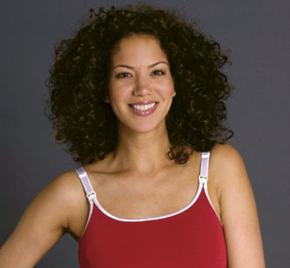
DO NOT:
3. Wear spaghetti straps!
NO

Slide 33
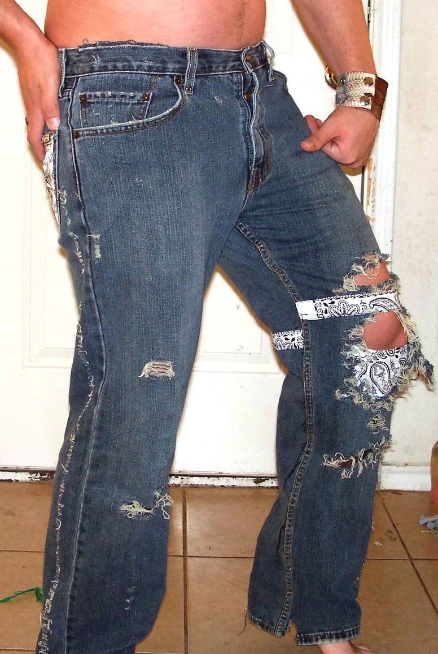
DO NOT:
4. Wear
jeans with holes above the knee!

Slide 34

Remember . . .
This is school, not a club.

Slide 35

DO NOT:
5. Wear hats or bring them to class!

Slide 36

DO NOT:
6. Bring backpacks to class!
NO

Slide 37

DO NOT:
7. Bring coats to class!

Slide 38
If you always get cold,
then bring a sweater or
sweatshirt with you.

Slide 39
Follow the dress code, or . . .
You will be sent to the
office or suspended.

Slide 40

8. Cheating

Slide 41
Ms. Yatoma and the rest
of the world consider
cheating to be the
following:

Slide 42
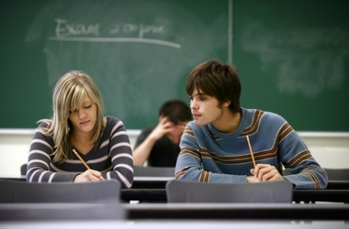
a. Copying answers from someone else’s work, even with his/her permission.

Slide 43

b. Looking at someone else’s paper and copying.

Slide 44
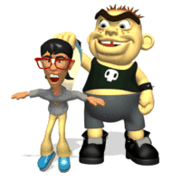
c. Having someone else do your work for you.

Slide 45
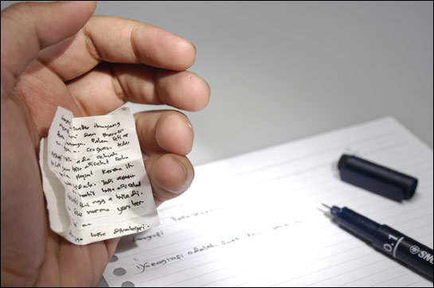
d. Using cheat sheets.

Slide 46

BE HONEST!!! It’s
better to tell the truth
than to cheat!

Slide 47
Now . . . let’s make
1st Semester the best semester ever!

Slide 48




